Slide 1
Digital Signal Processing in Radio Astronomy
An NSF Research Experience for Teachers Program
Pranav Sanghavi and Kevin Bandura
West Virginia University,
John Makous
Providence Day School
Howard Chun
Cranston High School East
Notes:
Hello my name is Pranav Sanghavi. From WVU
I shall speak about DSPIRA an NSF funded research experience for teachers site at WVU

Slide 2
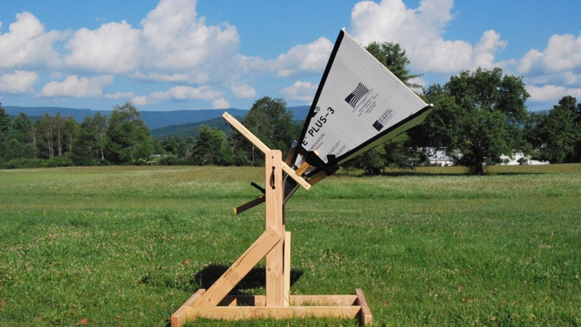
Why Radio Astronomy?
An inherently interdisciplinary field of study.
Historically founded by Radar Engineers.
Involves almost every aspect of science and engineering: physics, chemistry, mechanical, electrical, and radio frequency engineering, and computer science
Notes:
Why is Radio Astronomy appropriate as a framework to teach Engineering in a classroom setting?
Inherently interdisciplinary
Historically founded by radar engineers after world war 2
The Radio telescope developed as part of our program can be used as a stepping stone to teach various STEM topics
Physics by measuring the motion of the galaxy
Chemistry by demonstrating atomic spectra by way of Neutral Hydrogen. Hydrogen the most common element in universe

Slide 3
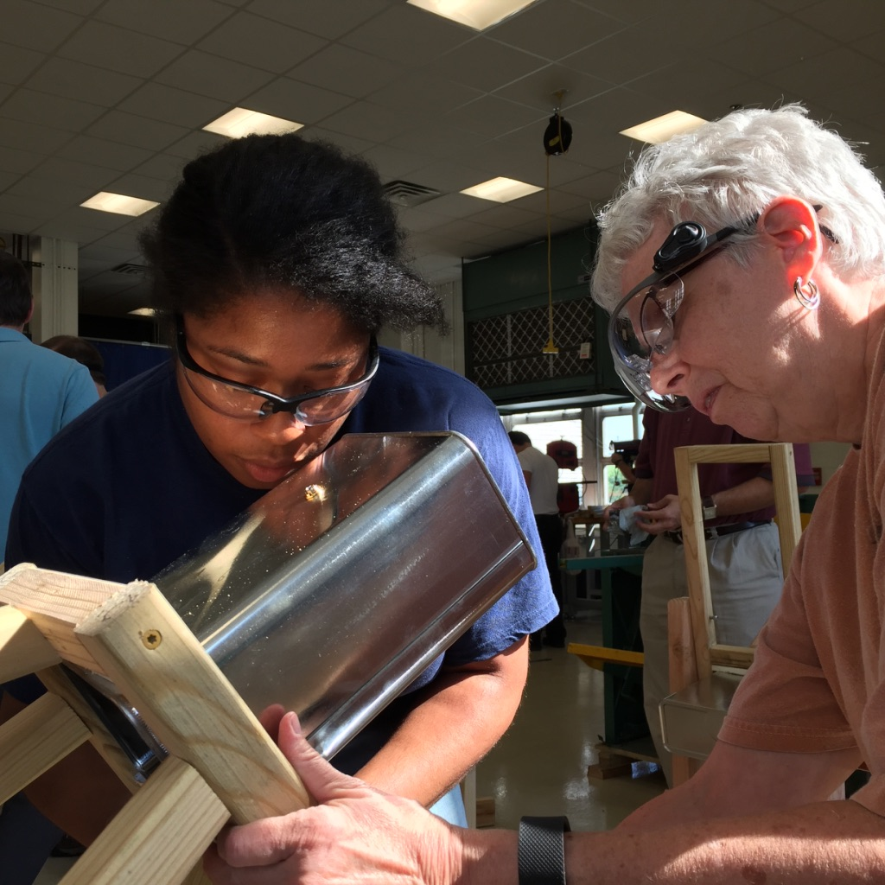
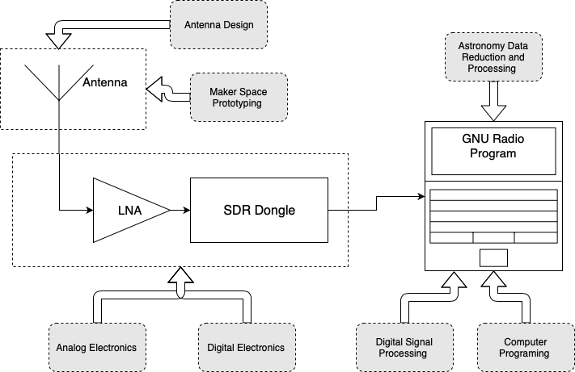
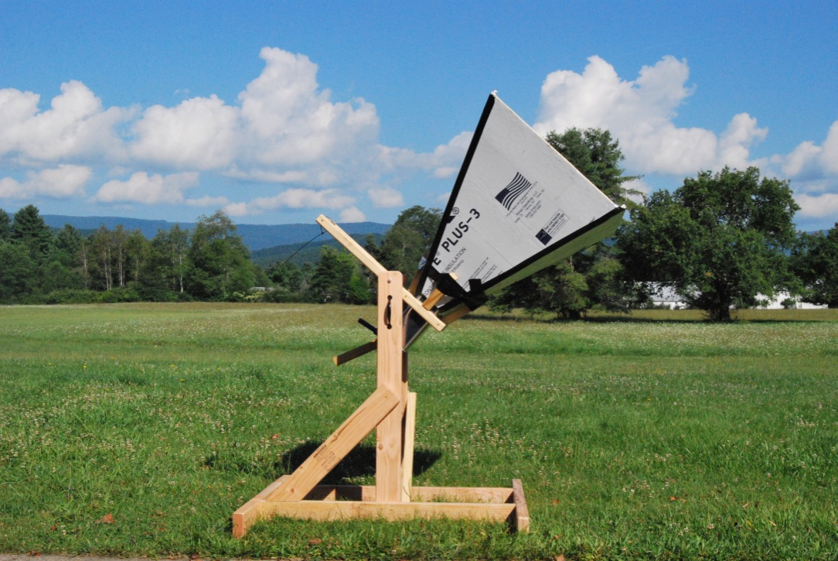
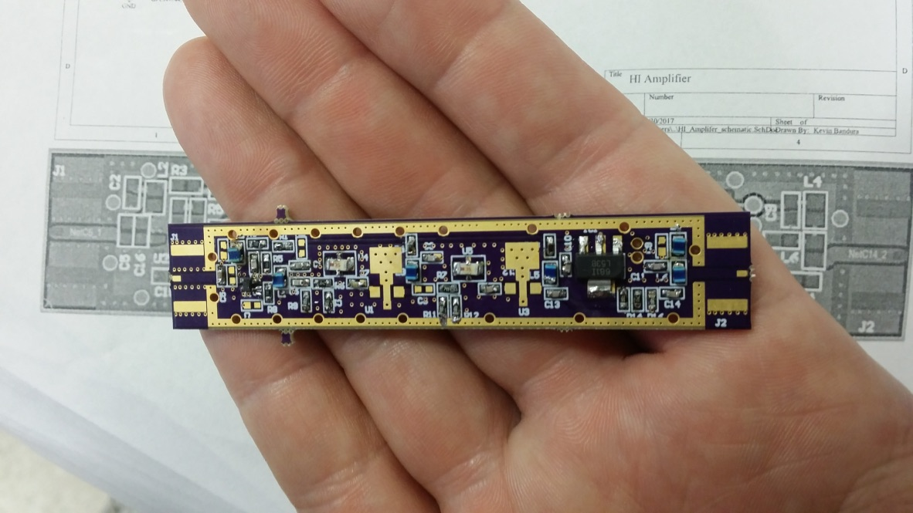
A Radio Telescope Pipeline
Notes:
Shown is a simple typical modern radio astronomical set up.. Astronomical signals from the galaxy are picked up by the antenna, amplified by the LNA, digitized by, in our set up, a software defined radio dongle and finally the signal is processed by a computer program. The emphasis of our program is on the DSP however to conduct a meaningful experiment a teacher needs to have functional understanding of every aspect of the pipeline. I shall go through every step

Slide 4
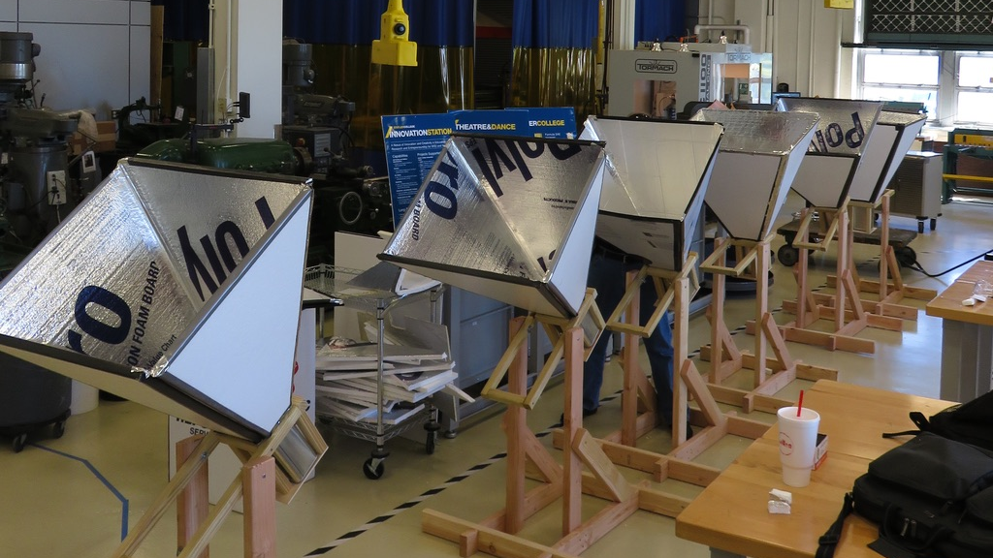
Building the Antennas and Mount
Notes:
First
build a horn antenna
tuned at the neutral hydrogen line.
The design is constrained by portability and cost
is built from materials and tools that can be readily sourced from a local hardware store

Slide 5
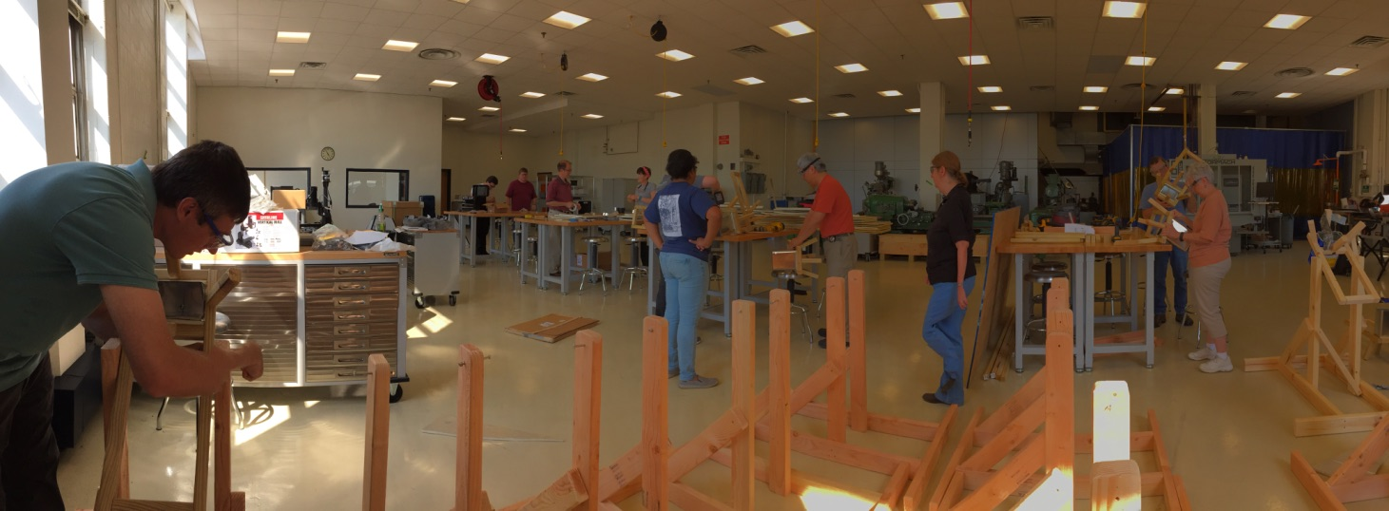
Notes:
The teachers are given a base design which they work on to build in the maker space at WVU. They also work on iterations of the design to improve its portability or cost or durability whichever possible
Every participating teacher builds an antenna to take with them to their classrooms

Slide 6
A Radio Telescope Pipeline
Notes:
The electrical signal from the antenna needs to be amplified by an amplifier

Slide 7
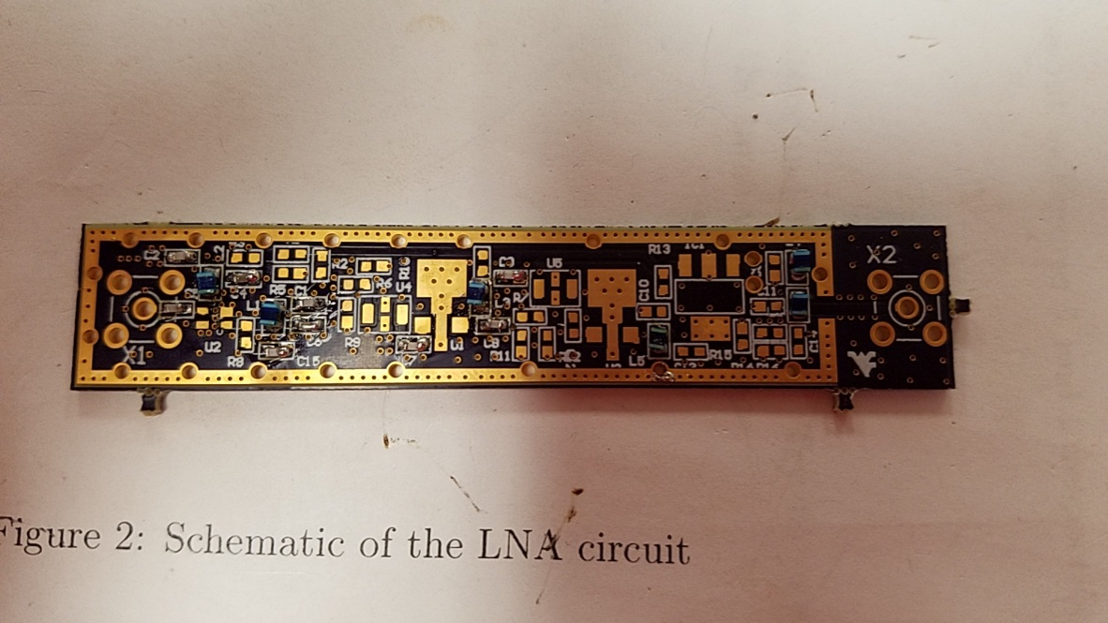
Assembling Low Noise Amplifiers
Notes:
The LNA is designed to amplify signals around the neutral hydrogen line in noisy environments. They were designed in house at WVU.

Slide 8
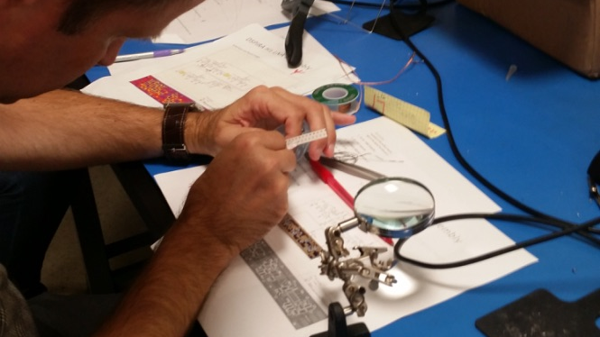
Notes:
The teachers assemble and learn to test and troubleshoot them. Most restrictive/most readily available we hope to change that

Slide 9
A Radio Telescope Pipeline
Notes:
The amplified analog signal is digitized to be processed

Slide 10
A Radio Telescope Pipeline
Notes:
SDR dongles are versatile devices that do a two fold job of tuning the incoming signal and converting analog signals to digital

Slide 11
A Radio Telescope Pipeline
Notes:
Finally we reach to the primary focus of our Program: Digital Signal Processing

Slide 12
Tool of Choice:
GNURadio is a free and open source software ecosystem that allows for immense flexibility
Programming with GNURadio is based on a flow based paradigm
The hardware required is inexpensive ( as low as $30. We use a device that costs <$200)

Slide 13
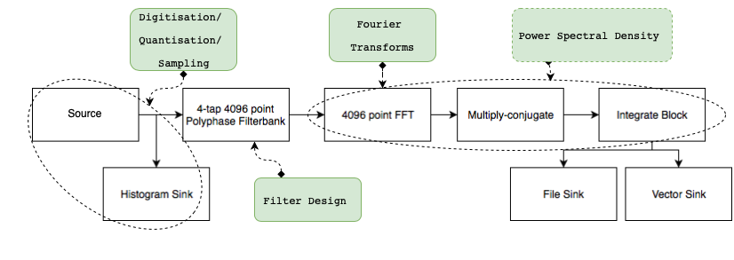
The DSP Pipeline of Our Radio Telescope
A Spectrometer
Notes:
Digital Signal Processing is a highly advanced engineering topic. We work with teachers to help them be experts by working from basics. We go through weeks of lectures and hands on laboratory exercises to build a radio spectrometer pictured. This is program is meant to be very intensive.

Slide 14
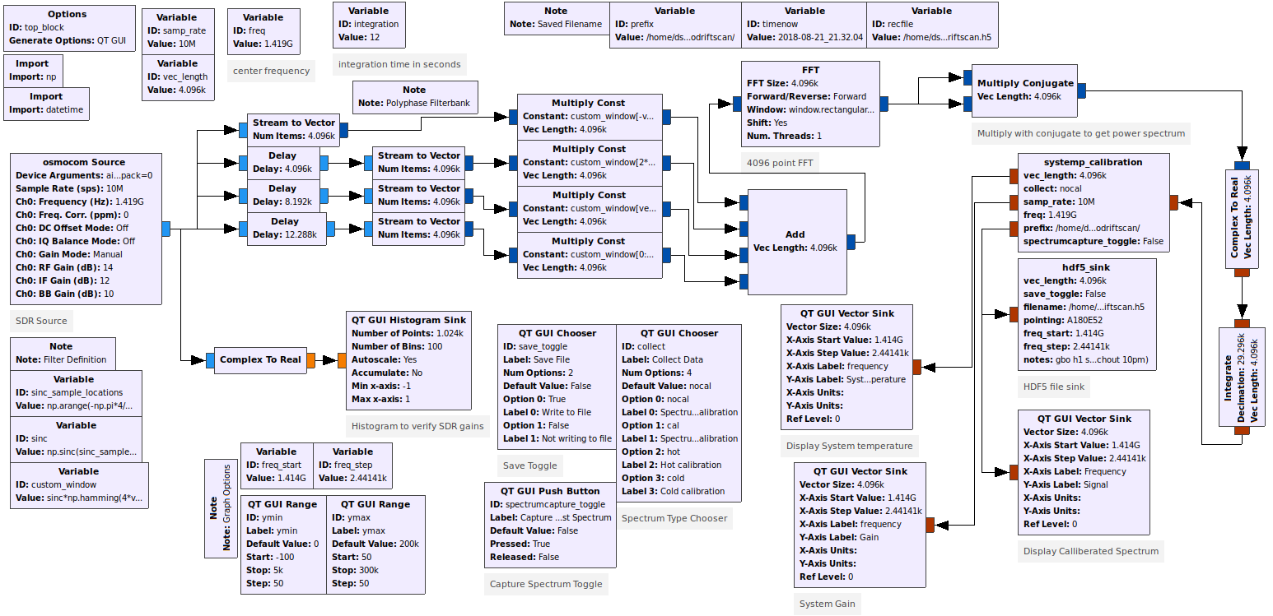
The DSP Pipeline Implemented in GNURadio
Notes:
Finally teachers build this in GNURadio, on closer look one can appreciate that this rather complicated flow diagram is exactly the same as the flow diagram in the previous slides.

Slide 15
The DSP Pipeline of Our Radio Telescope
A Spectrometer
Notes:
One can simply place and connect the built in blocks from GNURadio based on their understanding of the individual blocks of the flow graph.

Slide 16
The DSP Pipeline Implemented in GNURadio
Notes:
. Moreover more experienced teachers work to build custom block using the gnuradio framework to better capture the processed signal appropriate for a working radio astronomy back end. The teachers worked together to give feedback and construct a functional system

Slide 17
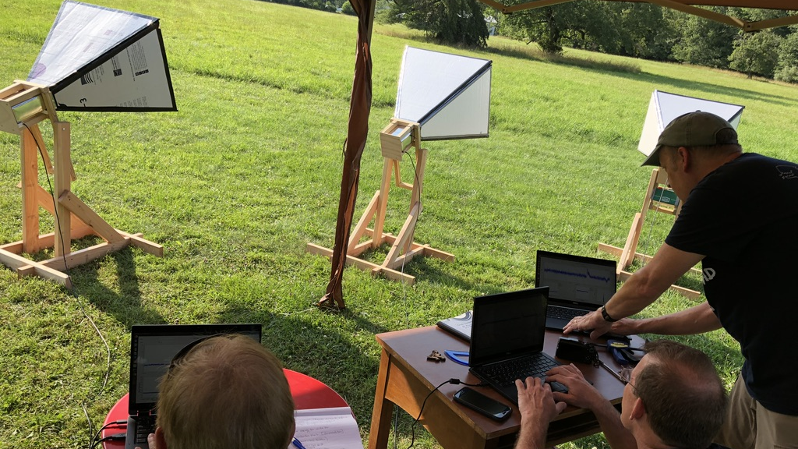
Observing with the Horn Antenna Telescope
Notes:
Once all the pieces are together, the teachers get a chance to do test the antennas at the green bank observatory WV. They also conduct several engineering experiments and scientific observations. They can use advanced facilities at gbo to better contextualize all they’ve learnt so far. For example use hot cold to characterize the system and compare with what they would get using other techniques at their school.

Slide 18
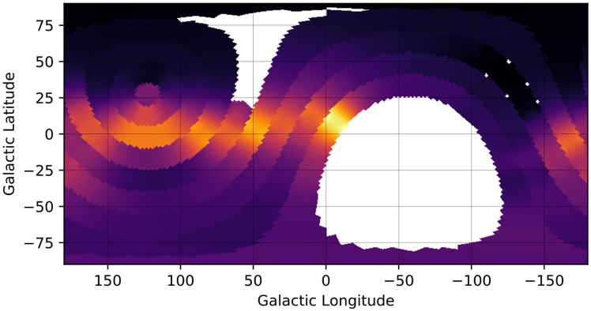
Notes:
They also conducted full science observations such as measuring the velocity curve of the galaxy and map the neutral hydrogen in the galaxy. Show is one such map made using a technique called drift scanning. By pointing the telescope at one point in the sky letting the sky “drift” over. Each band above id data from each telescope. The blanks here is when scope stopped working and the other is below the horizon

Slide 19
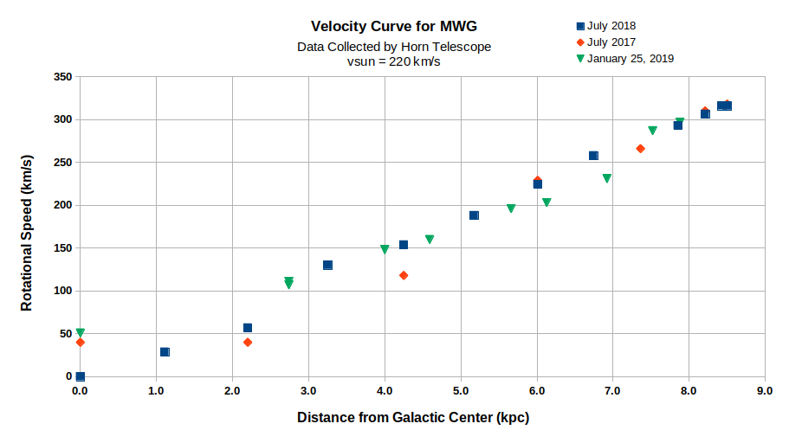
Notes:
Another science observation involves measuring the velocity curve of the milky way galaxy. Presented is a plot of multiple observations conducted by one of our teachers at green bank and in their class.

Slide 20
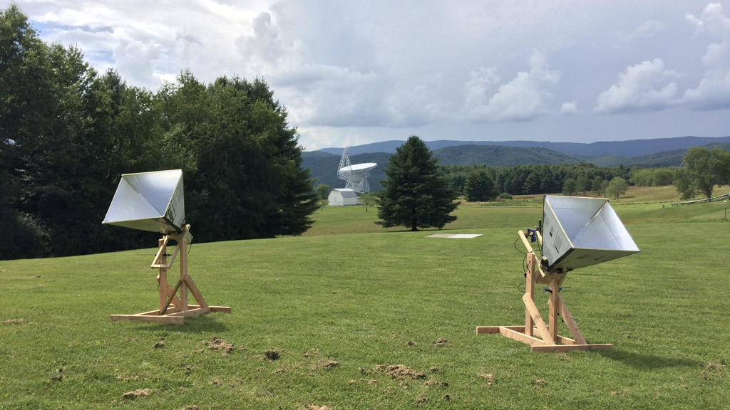
Lessons and Curricula
Notes:
Important to transfer all the intensive training to their classrooms

Slide 21
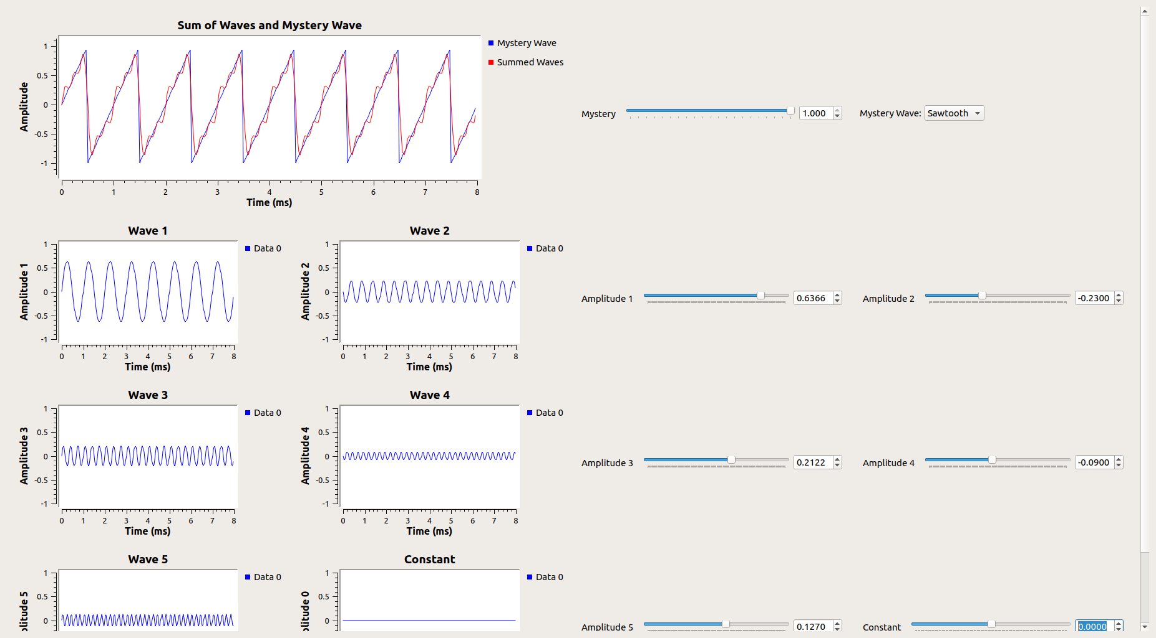
Time was dedicated by the teachers to work on designing lessons and activities that could be incorporated in their classrooms
These were designed by the teachers to work with the Next Generation Science Standards
Teachers accessed several tools to build exercises in DSP and Radio astronomy
Additionally they were able to use GNURadio program as interactive exercises
These lessons and activities are available online. They are hosted on the website: http://wvurail.org/cra/
Notes:
Used a bunch of tools in addition to gnuradio

Slide 22
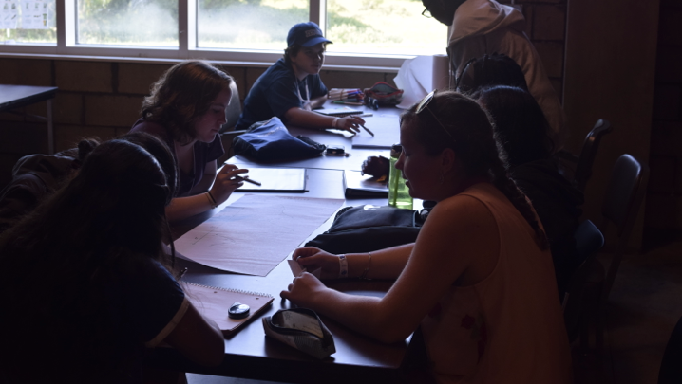
The Lessons and Activities were used at summer camps held at the Green Bank Observatory
Notes:
An analog activity using pencil and paper on the process of sampling.

Slide 23
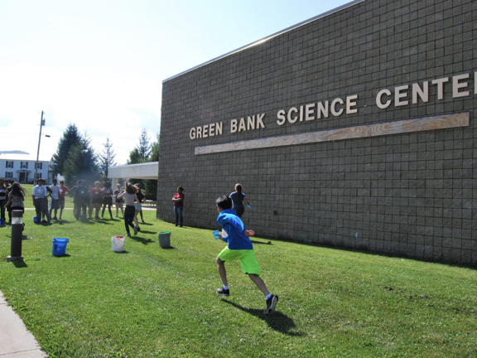
Notes:
An outdoor kinetic activity on the process of filtering

Slide 24
Challenges of taking Radio Astronomy back to classrooms
The computing requirements depend on the Linux operating system
Acquiring an appropriate LNA is expensive and building it non-trivial
Disseminating the material:
The teachers involved have a created a living repository of lessons and activities created during the program
It is maintained on an online web page (http://wvurail.org/cra/ )
Lessons are to be added by individual teachers as they conduct them in their respective classrooms
The website also has instructions and resources that would allow one to build a radio telescope on their own.

Slide 25
Challenges of taking DSP back to classrooms
The teachers have access for their reference all the detailed lessons and exercises they went through during the program
They are available to them and all on an online web page (http://wvurail.org/dspira/ )
Despite conducting small DSP exercises in their schools, it has been a challenge for the teachers to incorporate these into regular STEM classes and still cover the required materials.
This contrasts with Radio Astronomy, which our teachers have been rather successful at incorporating into regular classes.
Notes:
constant touch with teachers

Slide 26
Thank You
Link to presentation and details for the program: wvurail.org/dspiratalk
Our next session is in Summer 2019
You are all encouraged to apply: http://wvurail.org/dspira-2019/

